Slide 1
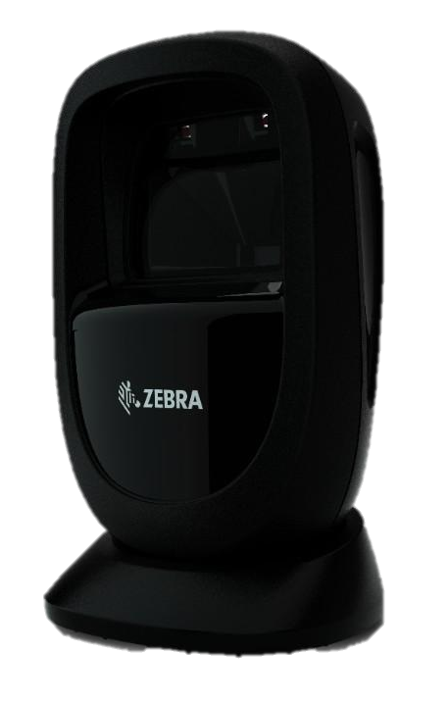
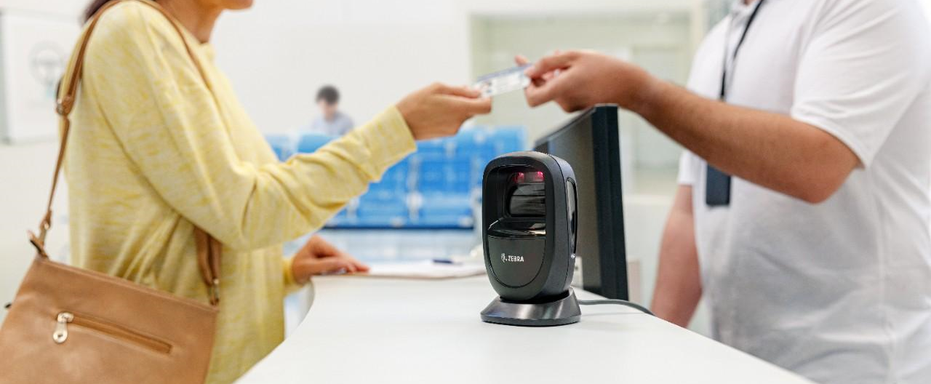
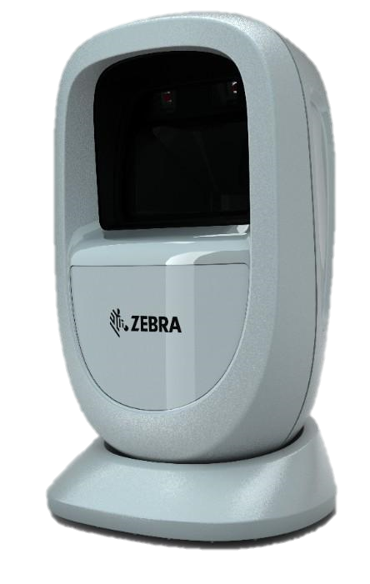
ENGLISH
SELL THE DS930X DURING FEBRUARY AND MARCH TO EARN 2X POINTS!
View Product List
*Promotion valid from 02/01/2020 – 03/31/2020
https://www.sellandwinclub.com/pages/products_list.php

Slide 2
PORTUGUSES
VENDA O DS930X DURANTE FEVEREIRO E MARÇO PARA GANHAR 2X PONTOS
Ver Lista de Produtos
*Promoção válida de 01/02/2020 a 31/03/2020
https://www.sellandwinclub.com/pages/products_list.php

Slide 3
SPANISH
VENDA EL DS930X DURANTE FEBRERO Y MARZO PARA GANAR 2X PUNTOS
Ver Lista de Productos
*Promoción válida del 01/02/2020 – 31/03/2020
https://www.sellandwinclub.com/pages/products_list.php

